Slide 1

Bike-Sharing Rental Demand Prediction

Slide 2
Group 4
Mentor – Karthik muskula
Group Members -
Bhakti Muley
Pratap S
Nehal Kakade
Shruti Bhosale
Supriya Dandolu
Suresh Bellapukonda
Moulika Uppala

Slide 3
Objective
To predict bike rent demands with accuracy.
To plan the renting facilities appropriately according to conditions affecting the bike demands.
To help in business decision-making using predicted data.

Slide 4
Dataset Details
Total records in dataset are 17,379
Target variable as cnt that is Total bike rents
Features included in dataset are –
Season like spring, winter, fall, summer.
Weather conditions temperature, humidity , wind speed
Days like working day or non-working day
Day of the week
Date along with year, month
Hour of the day
Types of customers as casual or registered

Slide 5
Exploratory Data Analysis(EDA)
To understand the relationship between target variable and other features in dataset.
The graphs plotted are :-
Distribution plot
Weather Focused Distribution plot
Season Focused plot
Hourly Bike Demand plot
Correlation Map

Slide 6
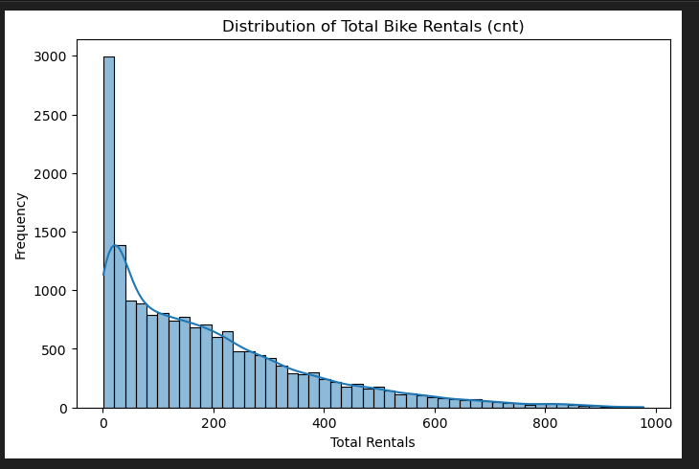
Distribution Plot
The Bike demand graph is right skewed.
It indicates majority rentals occur at lower counts.
Majority of rents lie between 50 to 300 bikes.

Slide 7
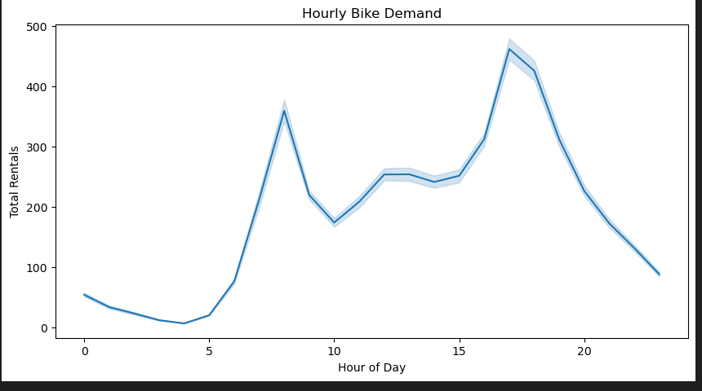
Hourly Bike Demand Plot
The graph shows high demand of bikes at peak hours.
Thus helping in understanding customer pattern.
Peak hours are 7-9 am and 5-7 pm where demand raises 2.5 times higher than usual.

Slide 8
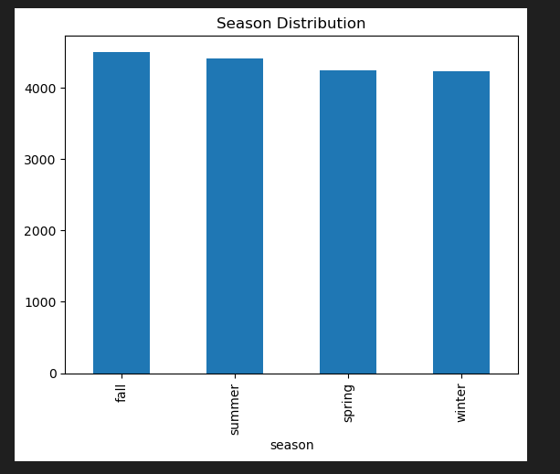
Season Focused Plot
The graph shows high demand of bikes in fall and summer season.
Thus indicating season plays important role in bike demand.
Fall and summer seasons contribute 55-60% of total rents.

Slide 9
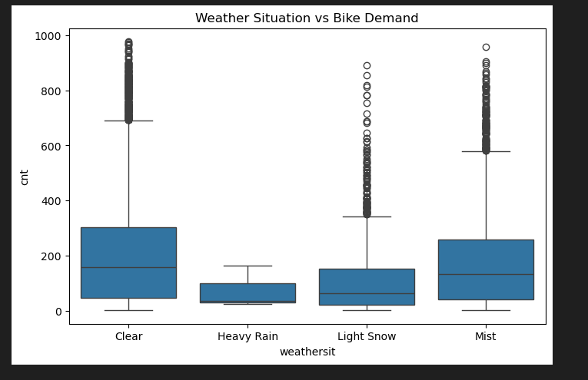
Weather Focused Distribution Plot
The graph shows high demand of bikes in clear weather.
While low demands in heavy rain.
High humidity reduces rents by 25-30%.

Slide 10
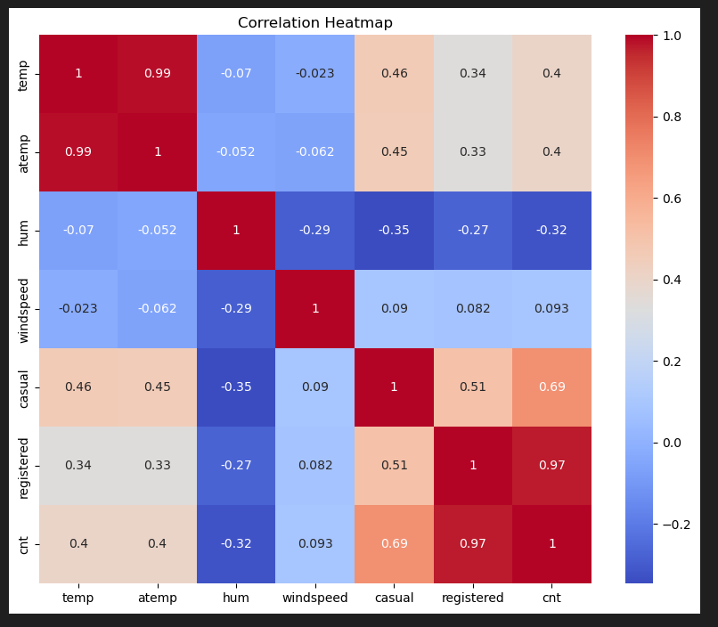
Correlation Map
This map shows high correlation of types of customer and the total bike rent.
While other factors also influence the target variable.
The highest correlation exists between temp and atemp as 0.99 and registered and cnt as 0.97.

Slide 11
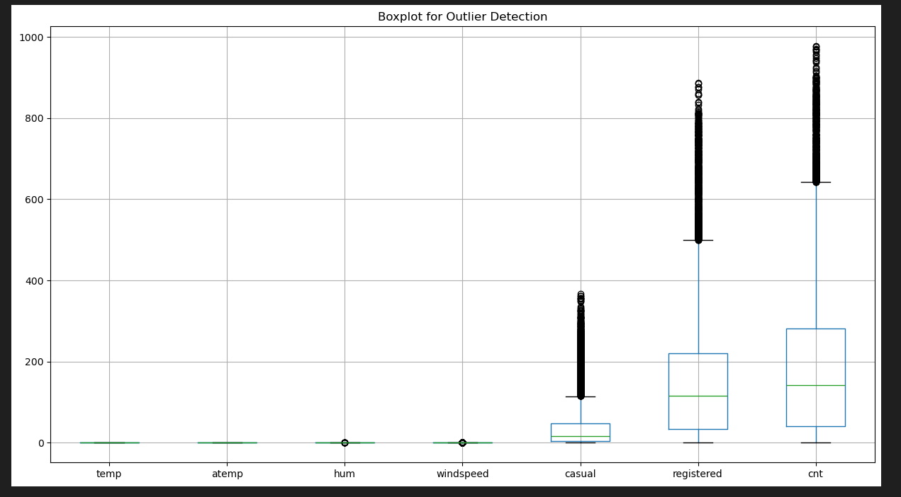
Outlier Analysis
The graph shows presence of outliers in few features of dataset.
These outliers actually indicate the peak hour rush and hence high values for the same.
Hence the outliers were retained for real world case analysis.

Slide 12
Feature Engineering
New features were created to improve model interpretability and performance.
The new features are –
Is_weekend – To know day of week as weekend or not.
Hour_category – To know whether it was morning, afternoon, evening, night.
Is_peak_hour – To know peak hour demand like 7,8,9 am and 5,6,7 pm.
Comfort_index – comfort condition based on humidity and temperature.

Slide 13
Categorical Feature Handling
To maintain model consistency the categorical features are encoded.
The encoding technique used id One-Hot Encoding.

Slide 14
Models Implemented
1) Linear Regression
2) Decision Tree
3) Random Forest
4) Gradient Boosting
5) XgBoost

Slide 15
Model Evaluation Metrics
Mean Absolute Error(MAE)
Root Mean Squared Error(RMSE)
R-Squared(R2)

Slide 16
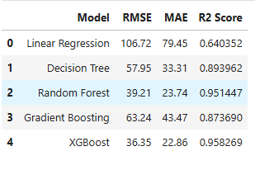
Initial Model Performance
Tree based models performed better than linear model initially.
Random Forest and XgBoost show overall good performance.

Slide 17
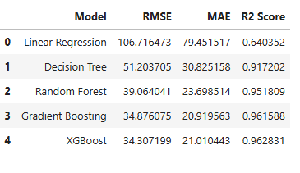
Model Performance After Hyper Parameter Tuning
After tuning the hyper parameters, model becomes balanced in terms of bias and variance.
The model that performs well after tuning is Xgboost.

Slide 18
Final Model Selection
XgBoost model is selected as final model to be deployed.
The reasons for selecting are –
Highest R2 score
Handles non-linear relationships
Robust to outliers
Fast and scalable

Slide 19
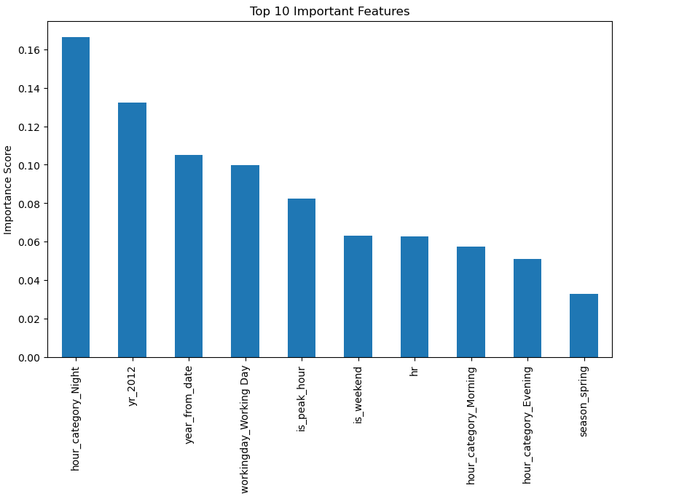
Feature Importance
The important features are –
Hour_category
Year
Working day
Is_peak_hour
Is_Weekend
season

Slide 20
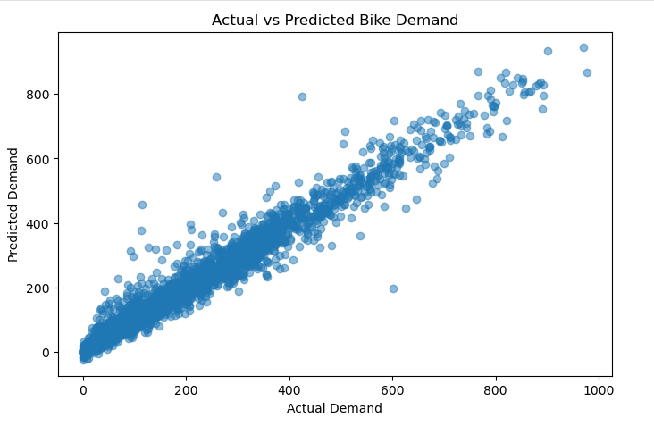
Actual vs Predicted Analysis
The graph shows the predictions closely follow the actual demand.
This observation indicates high accuracy of model.
During normal hours, predictions lie close to each other indicating the middle area of the plot.
During peak hours, deviation was observed indicating spread out points in the plot.

Slide 21
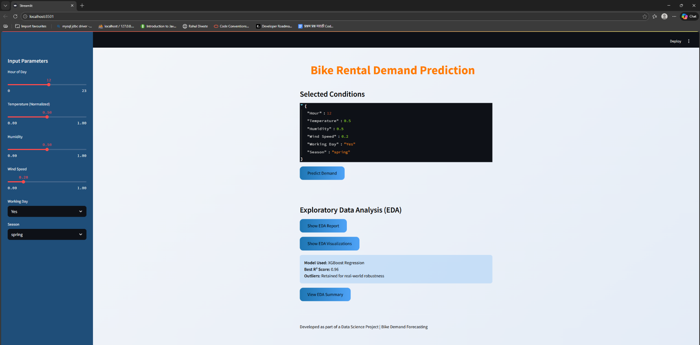
Application Page
User Input
Display of user inputs
Area to display result
Button for prediction
EDA Transparency

Slide 22
Features of Application
User-friendly interface
Real time prediction
EDA access transparency
Input based demand forecasting

Slide 23
Challenges Faced
Handling missing data – Replacing wrong words correctly, replacing null values with median was done to overcome this challenge.
Retaining outliers and training model with them. – The right measures like use of models that are robust to outliers needed to be used so that the model doesn’t show skewed predictions.
Model tuning without causing overfitting – The parameters like number of estimators and maximum depth needed to be checked carefully so that model won’t overfit.
Deployment and UI handling – Importing necessary libraries like joblib and using pkl extension to save model that is finalized. Using CSS to make web page look good and user-friendly.

Slide 24
Conclusion
Accurate prediction of bike demands is achieved.
XgBoost performed the best among other models and was chosen to be deployed.
The model helps in achieving proper plan and availability of bikes.
It improves overall customer satisfaction

Slide 25
Future Scope
The application and can be integrated with real-time weather API.
The model can be scaled so that the whole city area can be taken into consideration.
Improving UI with dashboards and dynamic features.

Slide 26
Thank YOU

